Slide 1



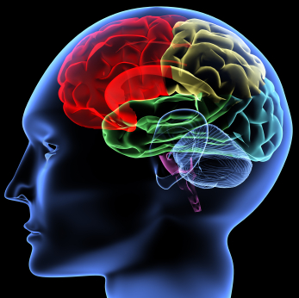



MOVE TO LEARN: Strategies For Improving Alertness & Engagement
In the Classroom
Liz Dobbins
Dr. Susan King

Slide 2




Have you seen this?
Notes:
Have you seen this? Playing with objects, poking another student, chewing, fidgeting, dozing, doodling, interrupting others, shouting out the answer before the teacher is ready, or generally breaking rules. These are all signs of lost alertness in the classroom.

Slide 3

WHY does this happen?
It’s natural!
Average attention span is 15 to 20 minutes
Notes:
Why do they lose alertness? It’s natural! Children’s attention spans appear to be related to their ages—approximately three to five minutes per year. So a kindergartener’s attention span can range from 15 to 20 minutes. Some researchers have concluded that an adult’s attention span is also 15 to 20 minutes.
It is the teacher’s responsibility to create and facilitate an environment that engages, motivates, and challenges the learner. What can be done to generate more attention, alertness, and engagement? The answer lies within the cognitive center—the brain.

Slide 4
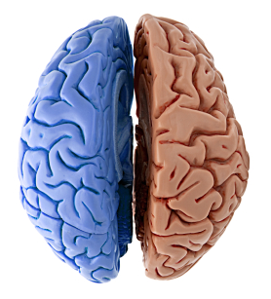
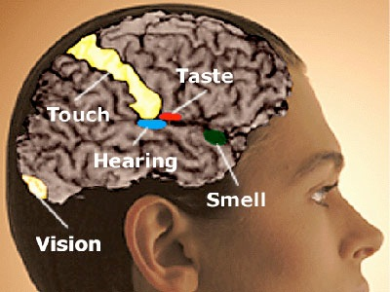
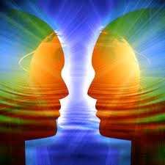
Notes:
The human brain is composed of two hemispheres, the left and right, which function like two networked computers. Each hemisphere controls the opposite side of the body. A thick bundle of nerves connect the hemispheres and allows them to communicate. Your brain uses both hemispheres to process information from OUTSIDE the body through the sensory systems—Visual (what you see), Auditory (what you hear), Olfactory (what you smell), Tactile (what you touch), and Gustatory (what you taste). A constant flow of sensory information stimulates communication between both sides of the brain. When the hemispheres work together, it increases alertness, engagement, learning and ultimately, academic achievement.

Slide 5
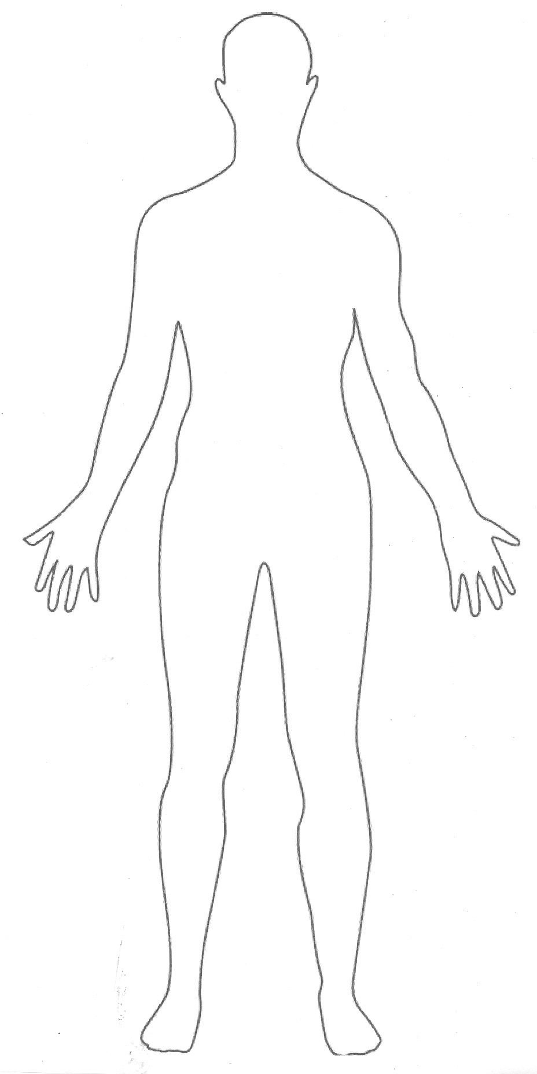
The Hidden Senses
OUTSIDE
Visual
Auditory
Olfactory
Tactile
Gustatory
INSIDE
Vestibular
Proprioception
Notes:
In addition to the sensory systems that deliver information to our brains from OUTSIDE of the body, there are two hidden senses that deliver information from INSIDE the body. The VESTIBULAR and PROPRIOCEPTION systems provide information about movement of the limbs, trunk and head as well as the body’s position in space—whether it is balanced or unbalanced. The vestibular system sends data to the brain from the inner ear. It helps us process movement and its effects on our posture, balance, eye movements, and motor planning. Proprioceptive data comes from receptors in our joints, tendons and muscles. It is the most effective system in helping to calm and organize our brain.

Slide 6
VESTIBULAR SYSTEM
  Information about movement through the inner ear
  How we process movement
  Effects on our posture, balance, eye movements, and motor planning.
  Can impact behaviors related to movement or changes in movement.

Slide 7
PROPRIOCEPTION
Control the movement and position of our joints and body in space.
Helps us to realize where our bodies are in relationship to other objects.
Combined with information from our vestibular system, helps modulate muscle tone throughout the entire body and helps us develop motor planning skills.
Receives information through receptors in our joints, tendons and muscles.
The most effective system in helping to calm and organize our brain.

Slide 8
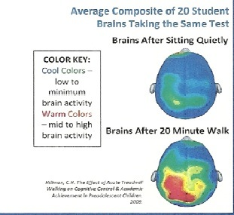
Movement Can Enhance Alertness & Engagement
Notes:
Research shows that specific, directed physical movements improve brain function and help prepare the brain for learning. Since the left hemisphere of the brain controls movements on the right side of the body, and the right hemisphere of the brain controls movements on the left side of the body, a person can refine the integration between the two sides of the brain through activities involving both sides of their body. These movements bring the two systems into closer collaboration and calibrate an appropriate balance between the two sides of the system. “Crossing the midline” refers to moving the arms and/or legs across the body from one side to the other. Successful integration between the two sides of the brain is necessary for improving all brain processes including those for reading, writing, academic achievement, motor skills development, and all other higher order cognitive processes.
Integrative movements help students prepare for learning by forcing the hemispheres to work together, assisting in energy and blood flow, decreasing muscle tension, and stimulating brain activity. Observe this composite diagram of brain activity of 20 student brains taking the same test. The students who took the test after sitting quietly showed low to minimum brain activity. However, the students who took the test after a 20 minute walk exhibited mid to high brain activity. Additional research shows that when a body is inactive for 20 minutes or more, there is a decline in neural communication. Neural pathways fade when they are not in use. The conclusion is that preparing the brain for learning incorporates specific brain-compatible movements that improve neural connections so that the brain hemispheres can communicate more effectively, and cognitive abilities, including alertness and engagement, are heightened.

Slide 9
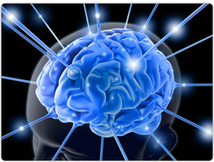
FIRE UP!
See bright colors
(Visual)
Rub lotion on hands
(Tactile)
Listen to music
(Auditory)
Taste hard candy
(Gustatory)
Smell a flower
(Olfactory)
Notes:
So to increase alertness, FIRE UP your students’ neural connections by stimulating all seven sensory systems. As the brain organizes and processes sensory input, students will exhibit enhanced concentration, impulse control, and overall improved classroom behavior. This, in turn, will increase their self esteem, creativity, and planning ability.
To utilize the systems that provide sensory information from outside the body, here are a few strategies…

Slide 10
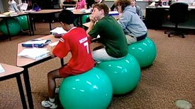
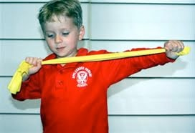
MOVE TO LEARN!
Vestibular System
(Movement)
Proprioception System
(Heavy work)
Notes:
MOVE TO LEARN!! What does that mean in a classroom? Using physical activity in the classroom to enhance academic performance.
The vestibular system provides sensory information from the inner ear; any change of position of the head provides direct stimuli—Bending, Turning, Leaning, Jumping, Swinging, or Rocking. Use vestibular activities before deskwork – start the day, class, lesson, that way, it pays off. Results of vestibular (movement) activities usually last 4-8 hours.
The proprioception system provides sensory information from the ‘heavy work’ of the joints and muscles.
Fidget toys
Chair push ups
Resistive bands for feet/legs
Moving desks or carrying books
Results of pressure touch (proprioceptive) strategies usually last 2-6 hours. (Unlikely to cause any problems, use frequently during day)
Combine ‘heavy work’ activities with academics. For example, a student must stand and lean on their desks while reading a sentence or answering a question, or create an academic obstacle course where after completing the physical activity at each station, an academic task must be performed
If the class is becoming restless or attention is decreasing, try a simple movement activity such as standing up, clapping hands, touching their toes, or switching desk

Slide 11
SENSORY CONCEPTS to remember
Fast movements tend to be alerting. Slow,
rhythmic movements tend to be calming (vestibular).
Fidget toys while stationary helps decrease
vocalizations and increase quiet (proprioception).
Recess provides opportunities for proprioceptive
and vestibular input and helps maintain control.
Notes:
Based upon neuro-physiological and learning research
Concept #1: Fast movements tend to be alerting. Slow, rhythmic movements tend to be calming.
Concept #2: Movement increases vocalization. (Use of a fidget toy while stationary helps decrease vocalizations and increase quiet)
Concept #3: Never, never, ever take recess away UNLESS there is danger.(Recess provides opportunities for proprioceptive and vestibular input and helps maintain control)
Quiet space : calming, hide out

Slide 12
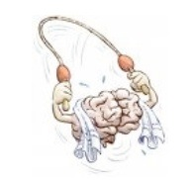
MOVE TO LEARN: Current Strategies
Integration
Language Arts
Math
More
Brain Breaks
Time to process
Refocus & reenergize
Laughter & fun
Notes:
Movement is exciting and can make learning fun, engaging and emotional. Research indicates that when cognitive information is linked with movement, retaining and recalling data is easier. By integrating movement with academic content, teachers provide a fresh approach to the presentation of language arts (reading, writing, spelling), math, and more. Children actually experience academic concepts by using the body. Integration offers multiple opportunities to review content, which is essential to learning.
Brain breaks are movement activities may or may not include academic content. Movement such as standing and stretching, walking to a water fountain, or playing “Simon Says” gives the brain time to process information, refocuses and reenergizes the brain before returning to academic content, and provides opportunities for laughter and fun in the classroom.

Slide 13
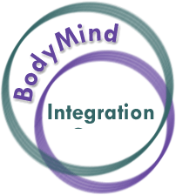
Integration
Stop and Scribble
Jumping Jack Math
Beach Ball Spelling
Sport Multiple Choice
Word Scramble Relay

Slide 14
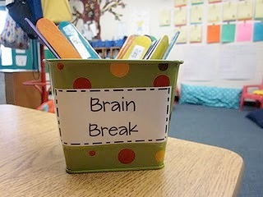
Brain Breaks
Keep It Up
Class Volleyball
Plates
Simon Says
Cross Lateral Moves
Dance

